Slide 1
Computer And Programming Fundamentals With C

Slide 2
What is C?
C is a general-purpose programming language created by Dennis Ritchie at the Bell Laboratories in 1972.
It is a very popular language.
C is strongly associated with UNIX, as it was developed to write the UNIX operating system.

Slide 3
Why Learn C?
It is one of the most popular programming language in the world.
If you know C, you will have no problem learning other popular programming languages such as Java, Python, C++, C#, etc, as the syntax is similar.
C is very fast, compared to other programming languages, like Java and Python
C is very versatile; it can be used in both applications and technologies

Slide 4
Characteristics of c language:
Simple and Efficient
The basic syntax style of implementing C language is very simple and easy to learn. This enables a programmer to redesign or create a new application.
Fast
C is a compiler-based program. This makes the compilation and execution of codes faster.
Extensibility
You can easily (and quickly) extend a C program. This means that if a code is already written, you can add new features to it with a few alterations. Basically, it allows adding new features, functionalities, and operations to an existing C program.
Function-Rich Libraries
C comes with an extensive set of libraries with several built-in functions that make the life of a programmer easy. Even a beginner can easily code using these built-in functions. You can also create your user-defined functions and add them to C libraries.

Slide 5
The following code is one of the simplest C programs that will help us the basic syntax structure of a C program.
#include <stdio.h>
int main()
{
printf(“hello world”);
return 0;
}

Slide 6
Program development
When we want to develop a program by using any programming language, we have to follow a sequence of steps. These steps are called phases in program development.

Slide 7
Program Development C
Program development is the process of creating application programs:
Program development life cycle contains 6 phases, which are as follows −
Problem Definition.
Problem Analysis.
Algorithm Development.
Coding & Documentation.
Testing & Debugging
Maintenance

Slide 8
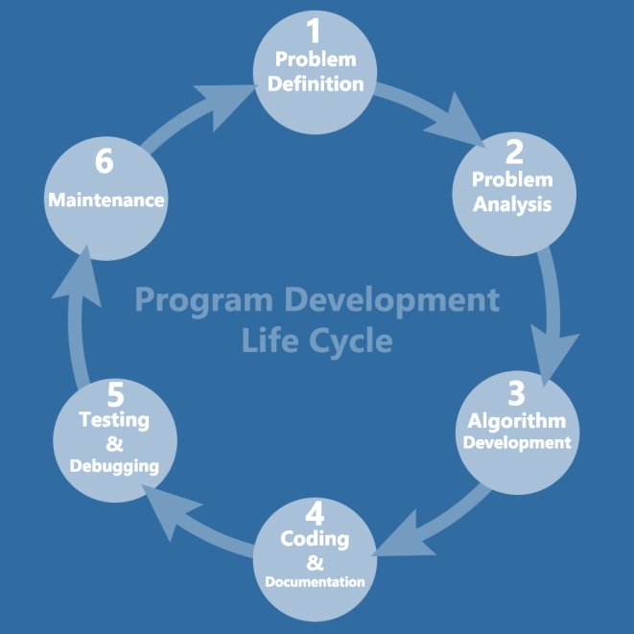

Slide 9
Problem Definition –In this phase, we need to understand what is the problem statement, what is our requirement and what is the output of the problem solution. All these are included in the first phase of program development life cycle.
Problem Analysis Here, we determine the requirements like variables, functions, etc. to solve the problem. It means that we gather the required resources to solve the problem, which are defined in the problem definition phase.
Algorithm Development Here, we develop a step-by-step procedure that is used to solve the problem. It is very important phase for the program development. We write the solution in step-by-step statements.

Slide 10
Coding & Documentation
Here, we use a programming language to write or implement the actual programming instructions for the steps defined in the previous phase. We construct the actual program in this phase. We write the program to solve the given problem by using the programming languages C.
Testing & Debugging
In this phase, we check whether the written code in the previous step is solving the specified problem or not. This means, we try to test the program whether it is solving the problem for various input data values or not. We also test if it is providing the desired output or not.
Maintenance
In this phase, we make the enhancements. Therefore, the solution is used by the end-user. If the user gets any problem or wants any enhancement, then we need to repeat all these phases from the starting, so that the encountered problem is solved or enhancement is added.

Slide 11
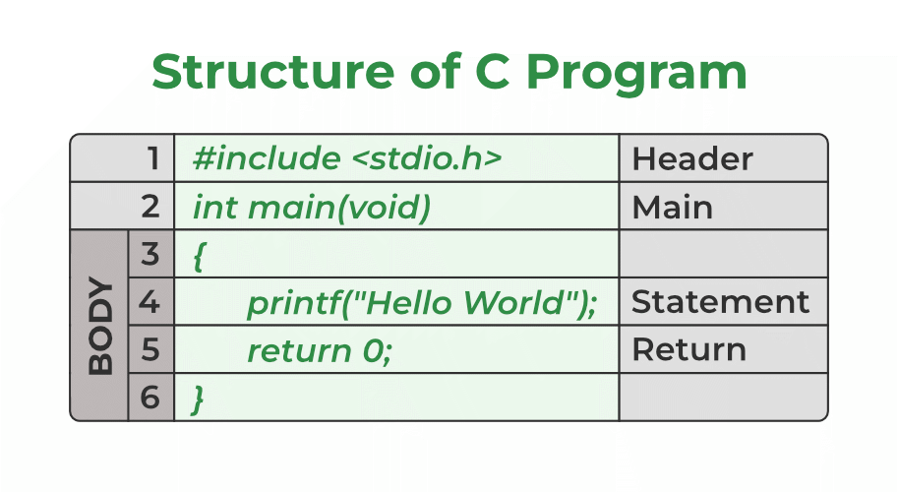
Structure of the C program

Slide 12
Components of a C Program:
1. Header Files Inclusion – Line 1 [#include <stdio.h>]
A header file is a file with extension .h which contains C function declarations and macro definitions to be shared between several source files. All lines that start with # are processed by a preprocessor which is a program invoked by the compiler.The .h files are called header files in C. Some of the C Header files:
stdio.h – Defines core input and output functions
math.h – Defines common mathematical functions.
2. Main Method Declaration – Line 2 [int main()]
The next part of a C program is to declare the main() function. It is the entry point of a C program and the execution typically begins with the first line of the main(). The empty brackets indicate that the main doesn’t take any parameter.

Slide 13
3. Body of Main Method – Line 3 to Line 6 [enclosed in {}]
The body of a function in the C program refers to statements that are a part of that function. It can be anything like manipulations, searching, sorting, printing, etc. A pair of curly brackets define the body of a function. All functions must start and end with curly brackets.
4. Statement – Line 4 [printf(“Hello World”);]
Statements are the instructions given to the compiler. In C, a statement is always terminated by a semicolon (;). In this particular case, we use printf() function to instruct the compiler to display “Hello World” text on the screen.
5. Return Statement – Line 5 [return 0;]
The last part of any C function is the return statement. The return statement refers to the return values from a function. This return statement and return value depend upon the return type of the function.

Slide 14
#include<stdio.h>
#include<conio.h>
int main()
{
int num1,num2,sum;
printf("enter two integers:");
scanf("%d %d", &num1, &num2);
sum = num1 + num2;
printf("%d + %d = %d", num1, num2, sum);
return 0;
}

Slide 15
Programming Using Algorithm And Flow Chart
Algorithms and flowcharts are different mechanisms used for designing different programs, particularly in computer programming.
An algorithm is a step-by-step summary of the procedure.
while on the other hand, a flowchart illustrates the steps of a program graphically.

Slide 16
Algorithm
Example:
Algorithm to add two numbers in C:
1) Start.
2) Accept Number one.
3) Accept Number two.
4) Add both the numbers.
5) Print the result.
6) End

Slide 17
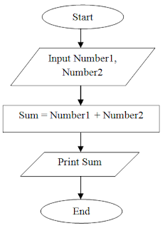
Flow chart

Slide 18
Flowchart Guidelines
To create a flowchart, you must follow the following current standard guideline:
Step 1: Start the program.
Step 2: Begin Process 1 of the program.
Step 3: Check some conditions and take a Decision (“yes” or “no”).
Step 4: If the decision is “yes”, proceed to Process 3. If the decision is “no”, proceed to Process 2 and return to Step 2.
Step 5: End of the program.

Slide 19
Character set
A character set is a set of alphabets, letters and some special characters that are valid in C language.
Alphabets
Uppercase: A B C ................................... X Y Z
Lowercase: a b c ....................................x y z
C accepts both lowercase and uppercase alphabets as variables and functions.
Digits
0 1 2 3 4 5 6 7 8 9

Slide 20
Special Characters in C Programming
, | < | > | . | _
( | ) | ; | $ | :
% | [ | ] | # | ?
' | & | { | } | "
^ | ! | * | / | |
- | \ | ~ | +

Slide 21
Token:-
A token in C can be defined as the smallest individual element of the C programming language that is meaningful to the compiler. It is the basic component of a C program.
Types of Tokens in C
The tokens of C language can be classified into six types based on the functions they are used to perform. The types of C tokens are as:

Slide 22
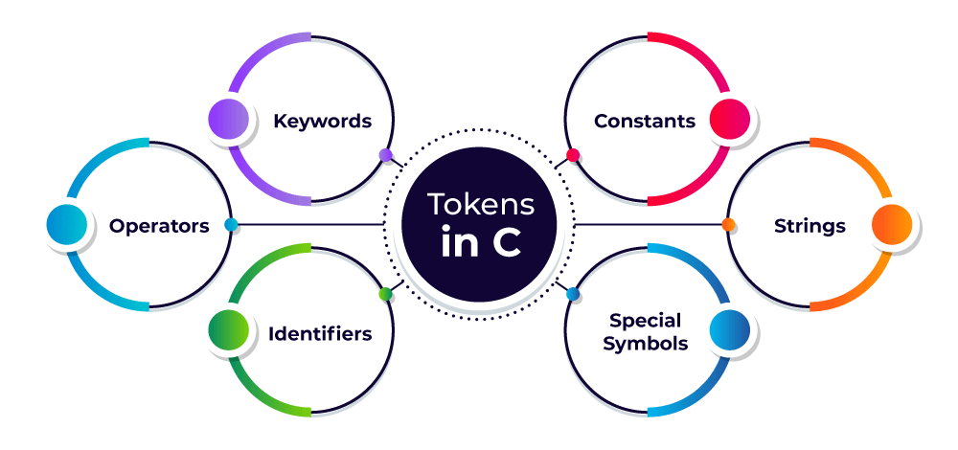
Keywords Identifiers Constants Strings Special Symbols Operators

Slide 23
Use of the Tokens in C
For instance, without words, you cannot create any sentence- similarly, you cannot create any program without using tokens in C language. Thus, we can also say that tokens are the building blocks or the very basic components used in creating any program in the C language.

Slide 24
C Keywords
Keywords are predefined, reserved words used in programming that have special meanings to the compiler. Keywords are part of the syntax and they cannot be used as an identifier. For example:
int money;
Here, int is a keyword that indicates money is a variable of type int (integer).
As C is a case sensitive language, all keywords must be written in lowercase.

Slide 25
Keywords
In ‘C’, there are 32 keywords. All keywords must be written in lower case.

Slide 26
These 32 keywords are classified into 3 types namely
1. Type related Keywords (16)
2. Storage related Keywords (4)
3. Control flow related Keywords (12)

Slide 27
1. Type related Keywords (16)
int | Short | Void | enum
float | Long | Struct | const
char | Signed | union | volatile
double | Unsigned | typedef | sizeof
char keyword
#include <stdio.h>
int main()
{
char c = 'a';
printf("%c", c);
return 0;
}
Output
a

Slide 28
2. Storage related Keywords (4)
Auto | Static | Register | Extern
auto keyword
#include <stdio.h>
int main()
{
auto int a = 10;
printf("%d", a);
}
Output
10

Slide 29
Control flow related keywords:
if | default | Goto | for
else | case | continue | while
switch | break | return | do
#include <stdio.h>
int main()
{
int a = 10;
if(a < 11)
{
printf("A is less than 11");
}
else
{
printf("A is equal to or "
"greater than 11");
}
return 0;
}

Slide 30
C Identifiers
Identifier refers to name given to entities such as variables, functions, structures etc.
Identifiers must be unique. They are created to give a unique name to an entity to identify it during the execution of the program. For example:
int money;
double accountBalance;
Here, money and accountBalance are identifiers.
Also remember, identifier names must be different from keywords. You cannot use int as an identifier because int is a keyword.

Slide 31
Identifiers:
Rules to name a particular identifier:
1. It must start with either alphabet or underscore.
2. Remaining letters may be alphabet, digit, underscore.
3. Identifier would not allow any special symbol except underscore.
4. An identifier can be of any length while most compilers of ‘C’ language recognize only the first 8 characters.
5. Do not use keywords as an identifier.

Slide 32
Difference between Keyword and Identifier:
 | KEYWORD | IDENTIFIER
 | Keywords are predefined word that gets reserved for working program that have special meaning and cannot get used anywhere else. | Identifiers are the values used to define different programming items such as variables, integers, structures, unions and others and mostly have an alphabetic character.
 | Specify the type/kind of entity. | Identify the name of a particular entity.
 | It always starts with a lowercase letter. | First character can be a uppercase, lowercase letter or underscore.
 | A keyword should be in lower case. | An identifier can be in upper case or lower case.

Slide 33
KEYWORD | IDENTIFIER
A keyword contains only alphabetical characters. | An identifier can consist of alphabetical characters, digits and underscores.
They help to identify a specific property that exists within a computer language. | They help to locate the name of the entity that gets defined along with a keyword.
No special symbol, punctuation is used. | No punctuation or special symbol except ‘underscore’ is used.
Examples of keywords are: int, char, if, while, do, class etc. | Examples of identifiers are: Test, count1, high_speed, etc.

Slide 34
Data Types
Each variable in C has an associated data type. It specifies the type of data that the variable can store like integer, character, floating, double, etc. Each data type requires different amounts of memory and has some specific operations which can be performed over it. The data type is a collection of data with values having fixed values, meaning as well as its characteristics.

Slide 35
The data types in C can be classified as follows:
Types | Description
Primary Data Types | Primary data types are the most basic data types that are used for representing simple values such as integers, float, characters, etc.
User Defined Data Types | The user-defined data types are defined by the user himself.
Derived Types | The data types that are derived from the primitive or built-in datatypes are referred to as Derived Data Types.

Slide 36
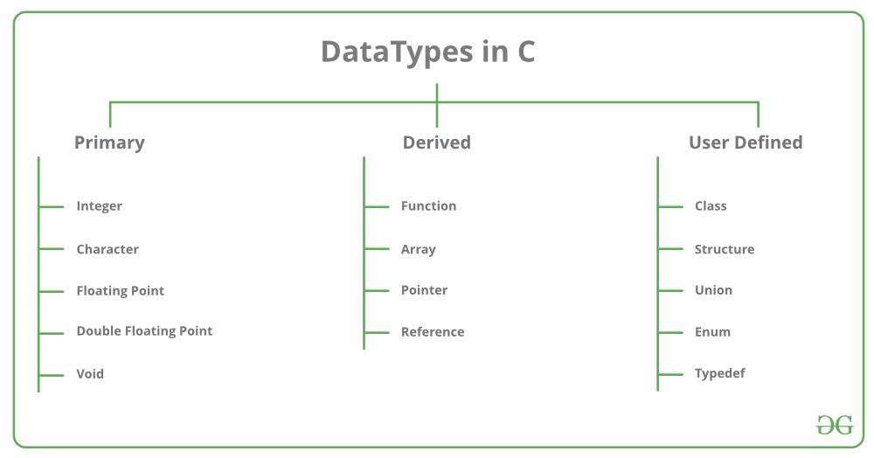
Different data types also have different ranges up to which they can store numbers. These ranges may vary from compiler to compiler.

Slide 37
Primary data types
Primary data types are also known as the fundamental data types because they are pre-defined or they already exist in the C language. All the other types of data types (derived and user-defined data types) are derived from these data types.
Primary data types in C are of 4 types:
int
char
Float
Double
void

Slide 38
Integer (int):
We use the keyword int for the integer data type.
The int data type is used to store non-fractional numbers which include positive, negative, and zero values.
The range of int is -2,147,483,648 to 2,147,483,647 and it occupies 2 or 4 bytes of memory, depending on the system you’re using. For example,
int a = 5550; int b = -90, int c = 0; int d = -0.5; //invalid
We can perform addition, subtraction, division, multiplication operations on int data type.

Slide 39
Character (char):
We use the keyword char for the character data type.
It is used to store single-bit characters and occupies 1 byte of memory.
You can store alphabets from A-Z(and a-z) and 0-9 digits using char datatype. For example,
char b = 'A'; char c = '0'; char d = 0; // ERROR
For char datatype, it is necessary to enclose the data within single quotes.
You can perform addition and subtraction operations on char datatype values.

Slide 40
Floating-point (float):
We use the keyword float for a floating-point data type.
The keyword float is used to store decimal numbers.
It occupies 4 bytes of memory and ranges from 1e-37 to 1e+37.
For example, float a = 0.05; float b = -0.005. float c = 1; // it will become c = 1.000000 because of type-casting
We can perform addition, subtraction, division, and multiplication operations on float data type.

Slide 41
Double (double):
We use the keyword double for the double data type.
The double datatype is used to store decimal numbers.
It occupies 8 bytes of memory and ranges from 1e-37 to 1e+37.
Here is how we use it in code, double a = 10.09; double b = -67.9;
The double datatype has more precision than float so double gives more accurate results as compared to float.
We can perform addition, subtraction, division, and multiplication operations on double data type.

Slide 42
Void (void):
This means no value.
This data type is mostly used when we define functions.
The void datatype is used when a function does not return any result.
It occupies 0 bytes of memory.
We use the void keyword for void data type.

Slide 43
Below is a list of ranges along with the memory requirement and format specifiers on the 32-bit GCC compiler.
Data Type | Size (bytes) | Range
short int | 2 | -32,768 to 32,767
unsigned short int | 2 | 0 to 65,535
unsigned int | 4 | 0 to 4,294,967,295
int | 4 | -2,147,483,648 to 2,147,483,647
long int | 4 | -2,147,483,648 to 2,147,483,647
unsigned long int | 4 | 0 to 4,294,967,295
long long int | 8 | -(2^63) to (2^63)-1
unsigned long long int | 8 | 0 to 18,446,744,073,709,551,615
signed char | 1 | -128 to 127
unsigned char | 1 | 0 to 255
float | 4 | 1.2E-38 to 3.4E+38
double | 8 | 1.7E-308 to 1.7E+308
long double | 16 | 3.4E-4932 to 1.1E+4932

Slide 44
Derived data type:
The data-types that are derived from the primitive or built-in datatypes are referred to as Derived Data Types.
Array
structure
union
pointers

Slide 45
User-Defined DataTypes:
The data types that are defined by the user are called the derived datatype or user-defined derived data type. These types include:
Class
Structure
Union
Typedef defined DataType

Slide 46
Constants and variables
What is a constant in C?
The constants in C are the read-only variables whose values cannot be modified once they are declared in the C program. The type of constant can be an integer constant, a floating constant, a string constant, or a character constant. In C language, the const keyword is used to define the constants.
.

Slide 47
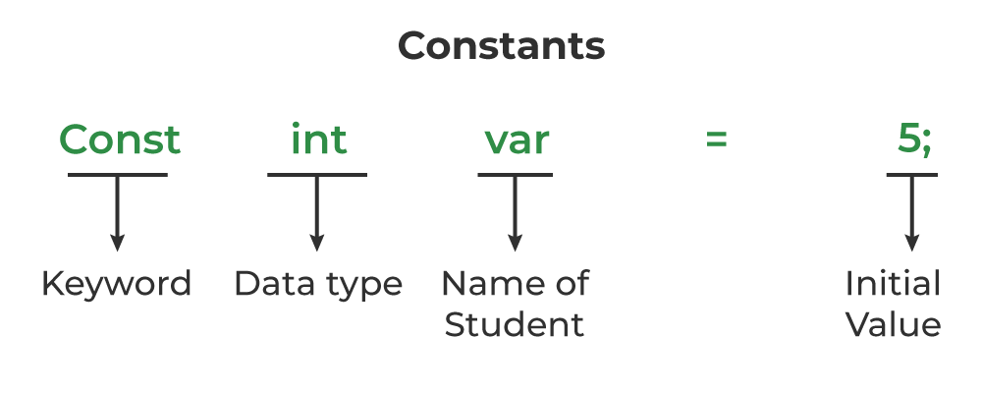
How to define a constant in C?
We define a constant in C language using the const keyword. Also known as a const type qualifier, the const keyword is placed at the start of the variable declaration to declare that variable as a constant.
Syntax to Define Constant
const data_type var_name = value;

Slide 48
Integer Constants: Whole number values, such as 42, -10, 0.
Floating-Point Constants: Decimal values with a fractional part, like 3.14, -0.5.
Character Constants: Single characters enclosed in single quotes, like 'A', '7', '@'.
String Constants: Sequences of characters enclosed in double quotes, like "Hello, World!".

Slide 49
C variables
What is a variable in C?
A variable in C is a memory location with some name that helps store some form of data and modified it when required. We can store different types of data in the variable and reuse the same variable for storing some other data any number of times.
The size of the variable depends upon the data type it stores.
C Variable Syntax
data_type variable_name = value;

Slide 50
There are 3 aspects of defining a variable:
Variable Declaration
Variable Definition
Variable Initialization
C Variable Declaration
Variable declaration in C tells the compiler about the existence of the variable with the given name and data type. No memory is allocated to a variable in the declaration.
2. C Variable Definition
In the definition of a C variable, the compiler allocates some memory and some value to it. A defined variable will contain some random garbage value till it is not initialized.
Example
int var;
char var2;
3. C Variable Initialization
Initialization of a variable is the process where the user assigns some meaningful value to the variable.
Example
int var; // variable definition
var = 10; // initialization
int var = 10; // variable declaration and definition

Slide 51
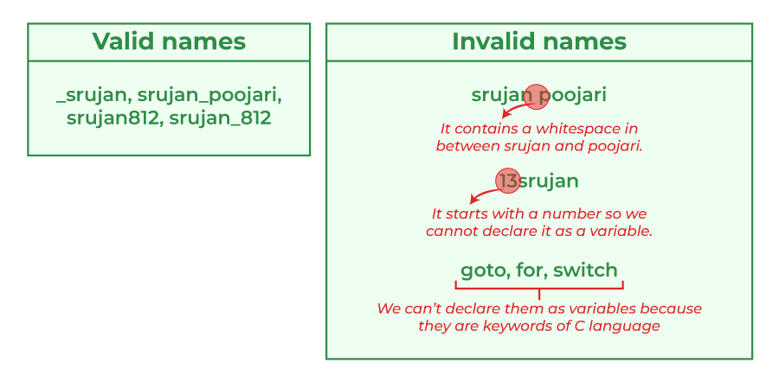
Rules for Naming Variables in C
You can assign any name to the variable as long as it follows the following rules:
A variable name must only contain alphabets, digits, and underscore.
A variable name must start with an alphabet or an underscore only. It cannot start with a digit.
No whitespace is allowed within the variable name.
A variable name must not be any reserved word or keyword.

Slide 52
C Variable Types
The C variables can be classified into the following types:
Local Variables
Global Variables
Static Variables
Automatic Variables
Register Variables

Slide 53
1. Local Variables in C
A Local variable in C is a variable that is declared inside a function or a block of code. Its scope is limited to the block or function in which it is declared.
#include <stdio.h>
int main()
{
int x = 10; // local variable
printf("%d", x);
}

Slide 54
2. Global Variables in C
A Global variable in C is a variable that is declared outside the function or a block of code. Its scope is the whole program i.e. we can access the global variable anywhere in the C program after it is declared.
Example of Global Variable in C.
// C program to demonstrate use of global variable
#include <stdio.h>
int x;
void function1() { printf("Function 1: %d\n", x); }
void function2() { printf("Function 2: %d\n", x); }
int main()
{
X=20;
function1();
X=50;
function2();
return 0;
}

Slide 55
#include<stdio.h>
#include<conio.h>
int x;
int function1()
{
printf("Function 1: %d\n", x);
}
int function2()
{
printf("Function 2: %d\n", x);
}
int main()
{
x=20;
function1();
x=50;
function2();
return 0;
}

Slide 56
3.Static Variables in C
A static variable in C is a variable that is defined using the static keyword. It can be defined only once in a C program and its scope depends upon the region where it is declared (can be global or local).
The default value of static variables is zero.
Syntax of Static Variable in C
static data_type variable_name = initial_value;

Slide 57
Automatic Variable in C
All the local variables are automatic variables by default. They are also known as auto variables.
Their scope is local and their lifetime is till the end of the block. If we need, we can use the auto keyword to define the auto variables.
The default value of the auto variables is a garbage value.
Syntax of Auto Variable in C
auto data_type variable_name;
Or
data_type variable_name; (in local scope)

Slide 58
Register Variables in C
Register variables in C are those variables that are stored in the CPU register instead of the conventional storage place like RAM. Their scope is local and exists till the end of the block or a function.
These variables are declared using the register keyword.
The default value of register variables is a garbage value.
Syntax of Register Variables in C
register data_type variable_name = initial_value;

Slide 59
C program to demonstrate the definition of register
// variable
#include <stdio.h>
int main()
{
// register variable
register int var = 22;
printf("Value of Register Variable: %d\n", var);
return 0;
}
Output
Value of Register Variable: 22

Slide 60
C Expressions
An expression is a formula in which operands are linked to each other by the use of operators to compute a value. An operand can be a function, a variable, an array element or a constant.
Let's see an example:
a-b;
In the above expression, minus character (-) is an operator, and a, and b are the two operands.
There are four types of expressions exist in C:
Arithmetic expressions
Relational expressions
Logical expressions
Conditional expressions
Each type of expression takes certain types of operands and uses a specific set of operators. Evaluation of a particular expression produces a specific value.

Slide 61
For example:
x = 9/2 + a-b;
The entire above line is a statement, not an expression. The portion after the equal is an expression.

Slide 62
Arithmetic Expressions
An arithmetic expression is an expression that consists of operands and arithmetic operators. An arithmetic expression computes a value of type int, float or double.
When an expression contains only integral operands, then it is known as pure integer expression when it contains only float operands, it is known as pure float expression, and when it contains both integral and float operands, it is known as mixed mode expression.
Evaluation of Arithmetic Expressions
The expressions are evaluated by performing one operation at a time.
When individual operations are performed, the following cases can be happened:
When both the operands are of type integer, then arithmetic will be performed, and the result of the operation would be an integer value. For example, 3/2 will yield 1 not 1.5 as the fractional part is ignored.

Slide 63
When both the operands are of type float, then arithmetic will be performed, and the result of the operation would be a float value. For example, 2.0/2.0 will yield 1.0, not 1.
If one operand is of type integer and another operand is of type float, then the mixed arithmetic will be performed. In this case, the first operand is converted into a float operand, and then arithmetic is performed to produce the float value. For example, 6/2.0 will yield 3.0 as the first value of 6 is converted into 6.0 and then arithmetic is performed to produce 3.0.
Let's understand through an example.
6*2/ (2+1 * 2/3 + 6) + 8 * (8/4)

Slide 64
Relational Expressions
A relational expression is an expression used to compare two operands.
It is a condition which is used to decide whether the action should be taken or not.
In relational expressions, a numeric value cannot be compared with the string value.
The result of the relational expression can be either zero or non-zero value. Here, the zero value is equivalent to a false and non-zero value is equivalent to true.

Slide 65
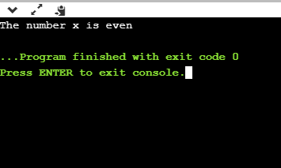
#include <stdio.h>
int main()
{
int x=4;
if(x%2==0)
{
printf("The number x is even");
}
else
printf("The number x is not even");
return 0;
}
Output

Slide 66
Logical Expressions
A logical expression is an expression that computes either a zero or non-zero value.
It is a complex test condition to take a decision.
Logical Expressions | Description
( x > 4 ) && ( x < 6 ) | It is a test condition to check whether the x is greater than 4 and x is less than 6. The result of the condition is true only when both the conditions are true.
x > 10 || y <11 | It is a test condition used to check whether x is greater than 10 or y is less than 11. The result of the test condition is true if either of the conditions holds true value.
! ( x > 10 ) && ( y = = 2 ) | It is a test condition used to check whether x is not greater than 10 and y is equal to 2. The result of the condition is true if both the conditions are true.

Slide 67
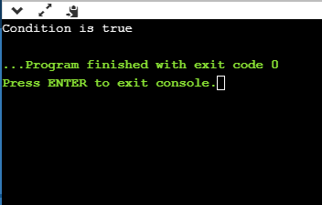
Let's see a simple program of "&&" operator.
#include <stdio.h>
int main()
{
int x = 4;
int y = 10;
if ( (x <10) && (y>5))
{
printf("Condition is true");
}
else
printf("Condition is false");
return 0;
}

Slide 68
Conditional Expressions
A conditional expression is an expression that returns 1 if the condition is true otherwise 0.
A conditional operator is also known as a ternary operator.
The Syntax of Conditional operator
Suppose exp1, exp2 and exp3 are three expressions.
exp1 ? exp2 : exp3
The above expression is a conditional expression which is evaluated on the basis of the value of the exp1 expression. If the condition of the expression exp1 holds true, then the final conditional expression is represented by exp2 otherwise represented by exp3.

Slide 69
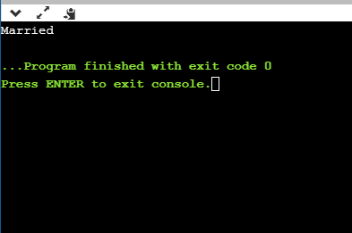
Let's understand through a simple example.
#include<stdio.h>
#include<conio.h>
int main()
{
int age = 25;
char status;
status = (age>22) ? 'M': 'U';
if(status == 'M')
printf("Married");
else
printf("Unmarried");
return 0;
}

Slide 70
C Programming Operators
An operator is a symbol that operates on a value or a variable. For example: + is an operator to perform addition.
C has a wide range of operators to perform various operations.
C Arithmetic Operators
An arithmetic operator performs mathematical operations such as addition, subtraction, multiplication, division etc on numerical values (constants and variables).

Slide 71
Operator | Meaning of Operator
+ | addition
- | subtraction
* | Multiplication
/ | Division
% | remainder after division (modulo division)

Slide 72
Working of arithmetic operators
#include <stdio.h>
int main()
{
int a = 9,b = 4, c;
c = a+b;
printf("a+b = %d \n",c);
c = a-b;
printf("a-b = %d \n",c);
c = a*b;
printf("a*b = %d \n",c);
c = a/b;
printf("a/b = %d \n",c);
c = a%b;
printf("Remainder when a divided by b = %d \n",c);
return 0;
}
Output -
a+b = 13
a-b = 5
a*b = 36
a/b = 2
Remainder when a divided by b=1

Slide 73
Unary operators are the operators that perform operations on a single operand to produce a new value.
Types of unary operators
Types of unary operators are mentioned below:
Unary minus ( – )
Increment ( ++ )
Decrement ( — )
NOT ( ! )
Addressof operator ( & )
Sizeof()

Slide 74
1. Unary Minus
The minus operator ( – ) changes the sign of its argument. A positive number becomes negative, and a negative number becomes positive.
int a = 10; int b = -a; // b = -10
Unary minus is different from the subtraction operator, as subtraction requires two operands.
C Program to illustrate the use of 'unary minus operator’
#include <stdio.h>
int main()
{
int positive Integer = 100;
int negative Integer = -positive Integer;
printf("Positive Integer = %d, positive Integer);
printf("Negative Integer = %d", negative Integer);
return 0;
}
Output
Positive Integer =-100
Negative Integer = 100

Slide 75
2. Increment
The increment operator ( ++ ) is used to increment the value of the variable by
The increment can be done in two ways:
2.1 prefix increment
In this method, The value of the operand will be altered before it is used.
Example:
int a = 1;
int b = ++a; // b = 2
2.2 postfix increment
In this method, the operator follows the operand (e.g., a++). The value operand will be altered after it is used.
Example:
int a = 1;
int b = a++; // b = 1
int c = a; // c = 2

Slide 76
// C program to illustrate increment #include <stdio.h> int main() { int a = 5; int b = 5; printf("Pre-Incrementing a = %d\n", ++a); printf("Post-Incrementing b = %d", b++); return 0; }
Output
Pre-Incrementing a = 6
Post-Incrementing b = 5

Slide 77
3. Decrement
The decrement operator ( — ) is used to decrement the value of the variable by
The decrement can be done in two ways:
prefix decrement
In this method, the operator precedes the operand (e.g., – -a). The value of the operand will be altered before it is used.
Example:
int a = 1;
int b = --a; // b = 0
postfix decrement
In this method, the operator follows the operand (e.g., a- -). The value of the operand will be altered after it is used.
Example:
int a = 1;
int b = a--; // b = 1
int c = a; // c = 0

Slide 78
// C program to illustrate decrement #include <stdio.h> int main() { int a = 5; int b = 5; printf("Pre-Decrementing a = %d\n", --a); printf("Post-Decrementing b = %d", b--); return 0; }
Output
Pre-Decrementing a =4
Post-Decrementing b = 5

Slide 79
4. NOT ( ! )
The logical NOT operator ( ! ) is used to reverse the logical state of its operand. If a condition is true, then the Logical NOT operator will make it false.
Example:
If x is true, then !x is false If x is false, then !x is true

Slide 80
// C program to illustrate NOT operator #include <stdio.h> int main() { int a = 10; int b = 5; if (!(a > b)) printf("b is greater than a\n"); else printf("a is greater than b"); return 0; }
Output
a is greater than b

Slide 81
C Assignment Operators
An assignment operator is used for assigning a value to a variable. The most common assignment operator is =
Operator | Example | Same as
= | a = b | a = b
+= | a += b | a = a+b
-= | a -= b | a = a-b
*= | a *= b | a = a*b
/= | a /= b | a = a/b
%= | a %= b | a = a%b

Slide 82
C Bitwise Operators
During computation, mathematical operations like: addition, subtraction, multiplication, division, etc are converted to bit-level which makes processing faster and saves power.
Bitwise operators are used in C programming to perform bit-level operations.
Visit bitwise operator in C to learn more.
Operators | Meaning of operators
& | Bitwise AND
| | Bitwise OR
^ | Bitwise exclusive OR
~ | Bitwise complement
<< | Shift left
>> | Shift right

Slide 83
Example 3: Assignment Operators
// Working of assignment operators
#include <stdio.h>
int main()
{
int a = 5, c;
c = a; // c is 5
printf("c = %d\n", c);
c += a; // c is 10
printf("c = %d\n", c);
c -= a; // c is 5
printf("c = %d\n", c);
c *= a; // c is 25
printf("c = %d\n", c);
c /= a; // c is 5
printf("c = %d\n", c);
c %= a; // c = 0
printf("c = %d\n", c);
return 0;
}
Example 3: Assignment Operators
// Working of assignment operators
#include <stdio.h>
int main()
{
int a = 5, c;
c = a; // c is 5
printf("c = %d\n", c);
c += a; // c is 10
printf("c = %d\n", c);
c -= a; // c is 5
printf("c = %d\n", c);
c *= a; // c is 25
printf("c = %d\n", c);
c /= a; // c is 5
printf("c = %d\n", c);
c %= a; // c = 0
printf("c = %d\n", c);
return 0;
}
Output
c = 5
c = 10
c = 5
c = 25
c = 5
c = 0

